Slide 1
Morse Code
Program
Submitted by:
Kartik
2210990486
Submitted to:
Thitoliya Sir
Under the supervision
of
Tkhitoliya Sir
Chitkara University Institute of Engineering and Technology (CUIET)
Chitkara University, Punjab

Slide 2
Outline
History
Introduction
Motivation
Justification for Project
Problem Statement
Objective
Methodology
Code Snippets
References

Slide 3
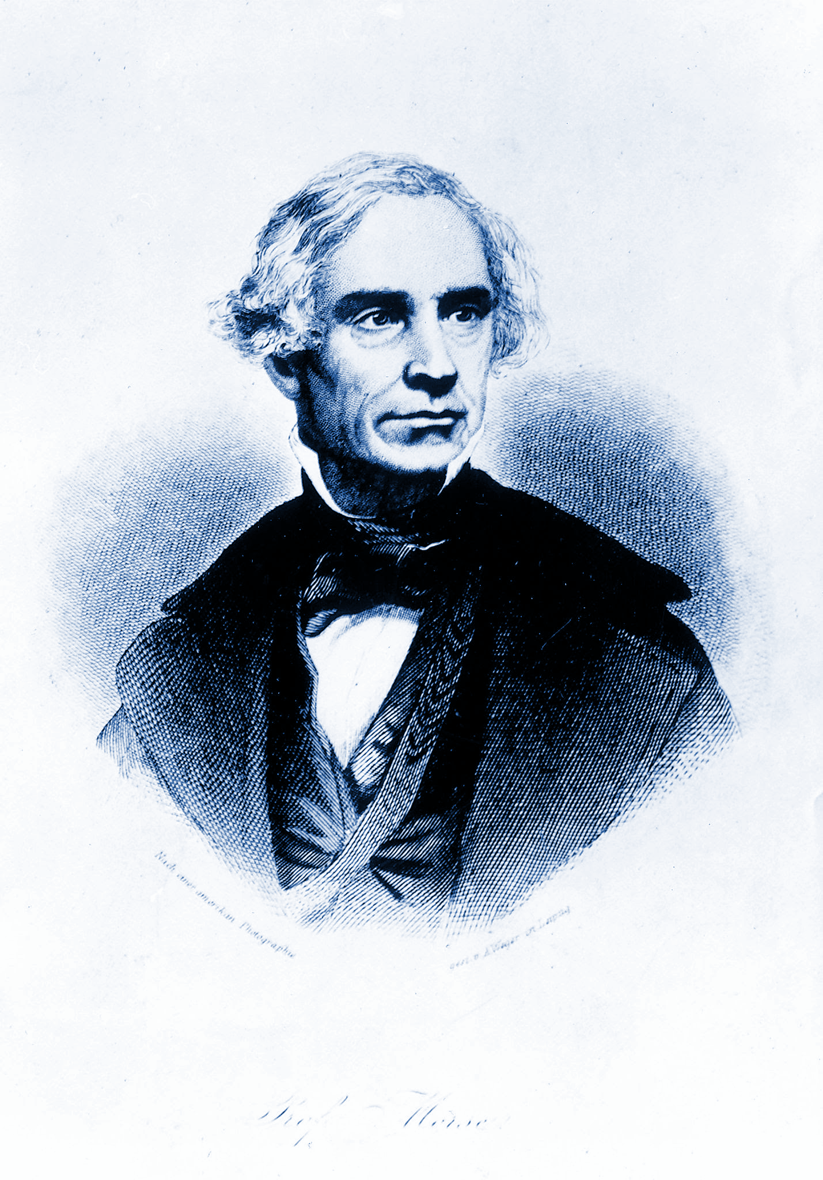
Morse Code History
Morse code is a method used in telecommunication to encode text characters as standardized sequences of two different signal durations, called dots and dashes, or dits and dahs. Morse code is named after Samuel Morse, one of the inventors of the telegraph.
Morse code can be memorized and sent in a form perceptible to the human senses, e.g. via sound waves or visible light, such that it can be directly interpreted by persons trained in the skill.
International Morse code encodes the 26 basic Latin letters a through z, one accented Latin letter (é), the Arabic numerals, and a small set of punctuation and procedural signals. (prosigns)
Samuel Morse
(1797 - 1872)

Slide 4
Introduction
Morse code is a method of transmitting text information as a series of on-off tones, lights, or clicks that can be directly understood by a skilled listener or observer without special equipment.
This is a Morse Code Translation Software, which is designed in Python.
I have used dictionaries to store the international morse code text.
I use decrypt and encrypt functions to make sure that the software is running correctly.
It is a cross-conversion platform which allows morse code to be converted into english, and vice versa.

Slide 5
Motivation
Motivation about the project was to provide historical knowledge to others, morse code was one of the first encrypted form of message, and encryption is so necessary nowadays.
Encryption is the process of encoding, information. This process converts the original representation of the information, known as plaintext, into an alternative form known as ciphertext.

Slide 6
Justification for Project
Easy to use, one can convert text into morse form, or morse into normal text.
It is used to transmit long messages into a much safer data encrypted form.
This is a multi-way project that allows users to get text converted to morse code, and to decrypt morse code back into text.

Slide 7
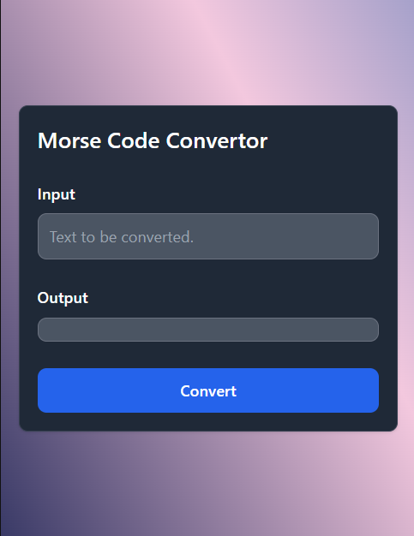
Problem Statement
1. There is an input box, you can input text in there and press “enter”, or click on “Convert” button.
2. Once clicked, output is displayed in the output tab.

Slide 8
Objective
The main objective of this project is to educate the audience, users around the world about the ways to encrypt your data. Morse being one of the first encryption algorithms provides an idea as to how far encryption has come in modern day lives.

Slide 9
Methodology
Design has been done using Html, Css, Tailwind, and Javascript.
Imported dictionary for every alphabet and number in the morse code table.
I have used different variables to properly organize the code.
I have used flask to integrate python project to html project.

Slide 10
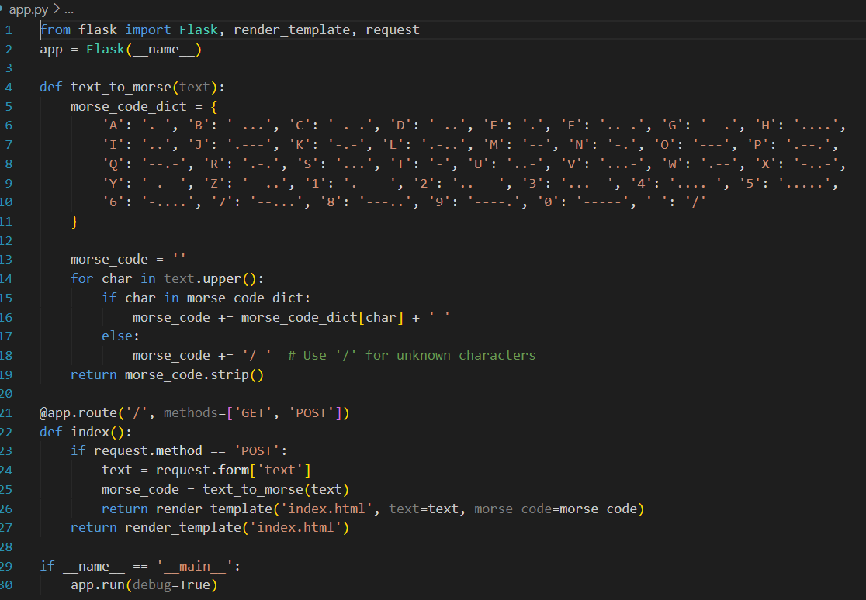
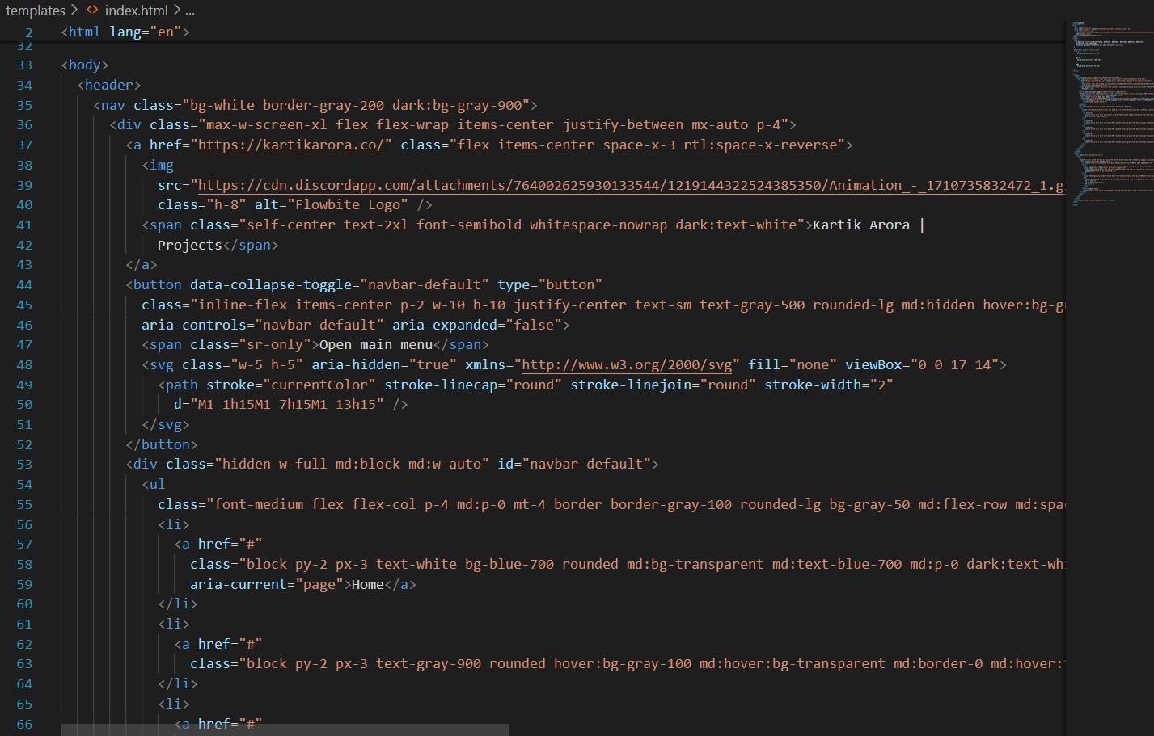
Code Snippets
Python Code
Front End Code

Slide 11
References
GeeksForGeeks https://www.geeksforgeeks.org/
Tailwind Documentation https://tailwindcss.com/docs/installation
Python Documentation
https://docs.python.org/3/
4) Wikipedia
https://en.wikipedia.org/wiki/Morse_code

Slide 12
Thank You

